Slide 1
Watson for Psychology
Drew Reynolds
Luke Bordanaro
Matthew Meck
Nicholas Ritter

Slide 2

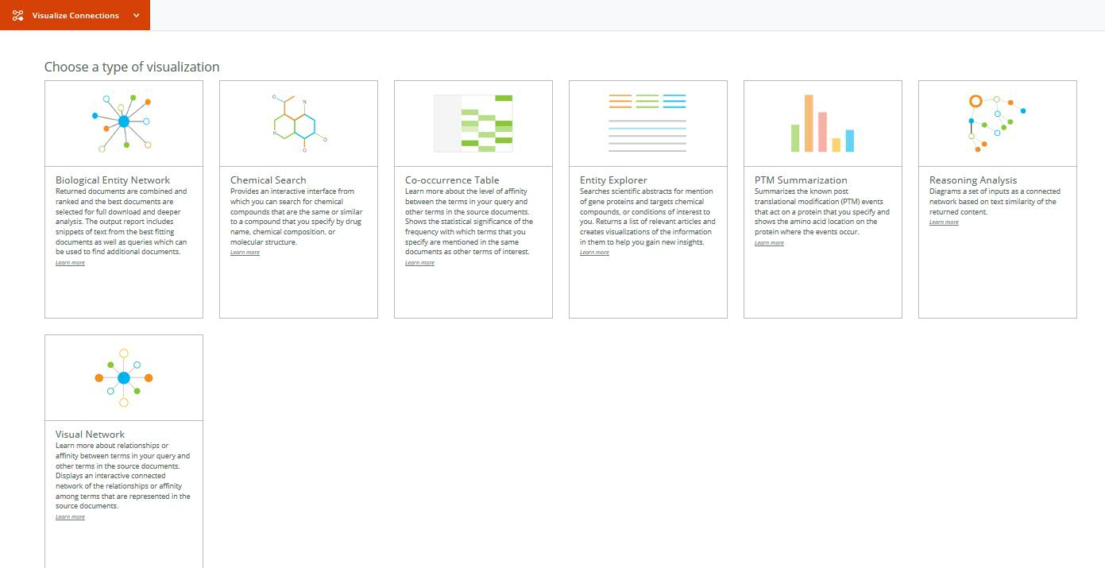
The Future of Psychology – A core component of healthcare
Consistency & Standardization
Remove biases and adhere to evidence-based practice and treatment guildelines
Quantify Mental Health
Watson for Psychology could be extended to many industries
Benefits
Access
Reduce barriers for people with mental health issues connecting w/ psychologist
Reduce Costs
Providing better recommendations will reduce downstream costs
The Bureau of Labor Statistics estimated in 2010 that the country had 156,300 mental health counselors. Access to mental health professionals is worse than for other types of doctors.
A 2007 study in the journal Psychiatric Services looked at 303 mental health patients who had, in the past year, thought about going to the doctor but decided against it. Cost was a barrier too: 47 percent cited financial obstacles as a reason not to seek treatment. Still, attitudinal barriers about the value of mental health care seemed to be be the biggest obstacle.
The United States spends $113 billion on mental health treatment. That works out to about 5.6 percent of the national health-care spending, according to a 2011 paper in the journal Health Affairs.
Mental health care is pricey, with 45 percent of the untreated citing cost as a barrier. A quarter of the 15.7 million Americans who received mental health care listed themselves as the main payer for the services, according to one survey that looked at those services from 2005 to 2009. The majority of those who did seek outpatient treatment had out-of-pocket costs between $100 and $5,000.
Notes:
THE INSPIRATION (1): Facts – mental healthcare costs mostly to outpatient care and prescription drugs, access is poor & most people do not think they need a psychologist or mental health provider, recent federal legislation requires more expansive coverage of mental health (preventative?)

Slide 3


How can we help combine Psychology and Mental Health?
Art of Psychology
Mental Health
Cannot prescribe
Inherent biases in testing and assessments
Lack of standardization
Data inconsistency
Chemical and biological basis for mental disorder
Diagnosis
Prescription
Statistical significant recommendations
for Psychology
Daily Monitoring
Analysis
Tracking
Predictive
Notes:
THE INSPIRATION (2):

Slide 4
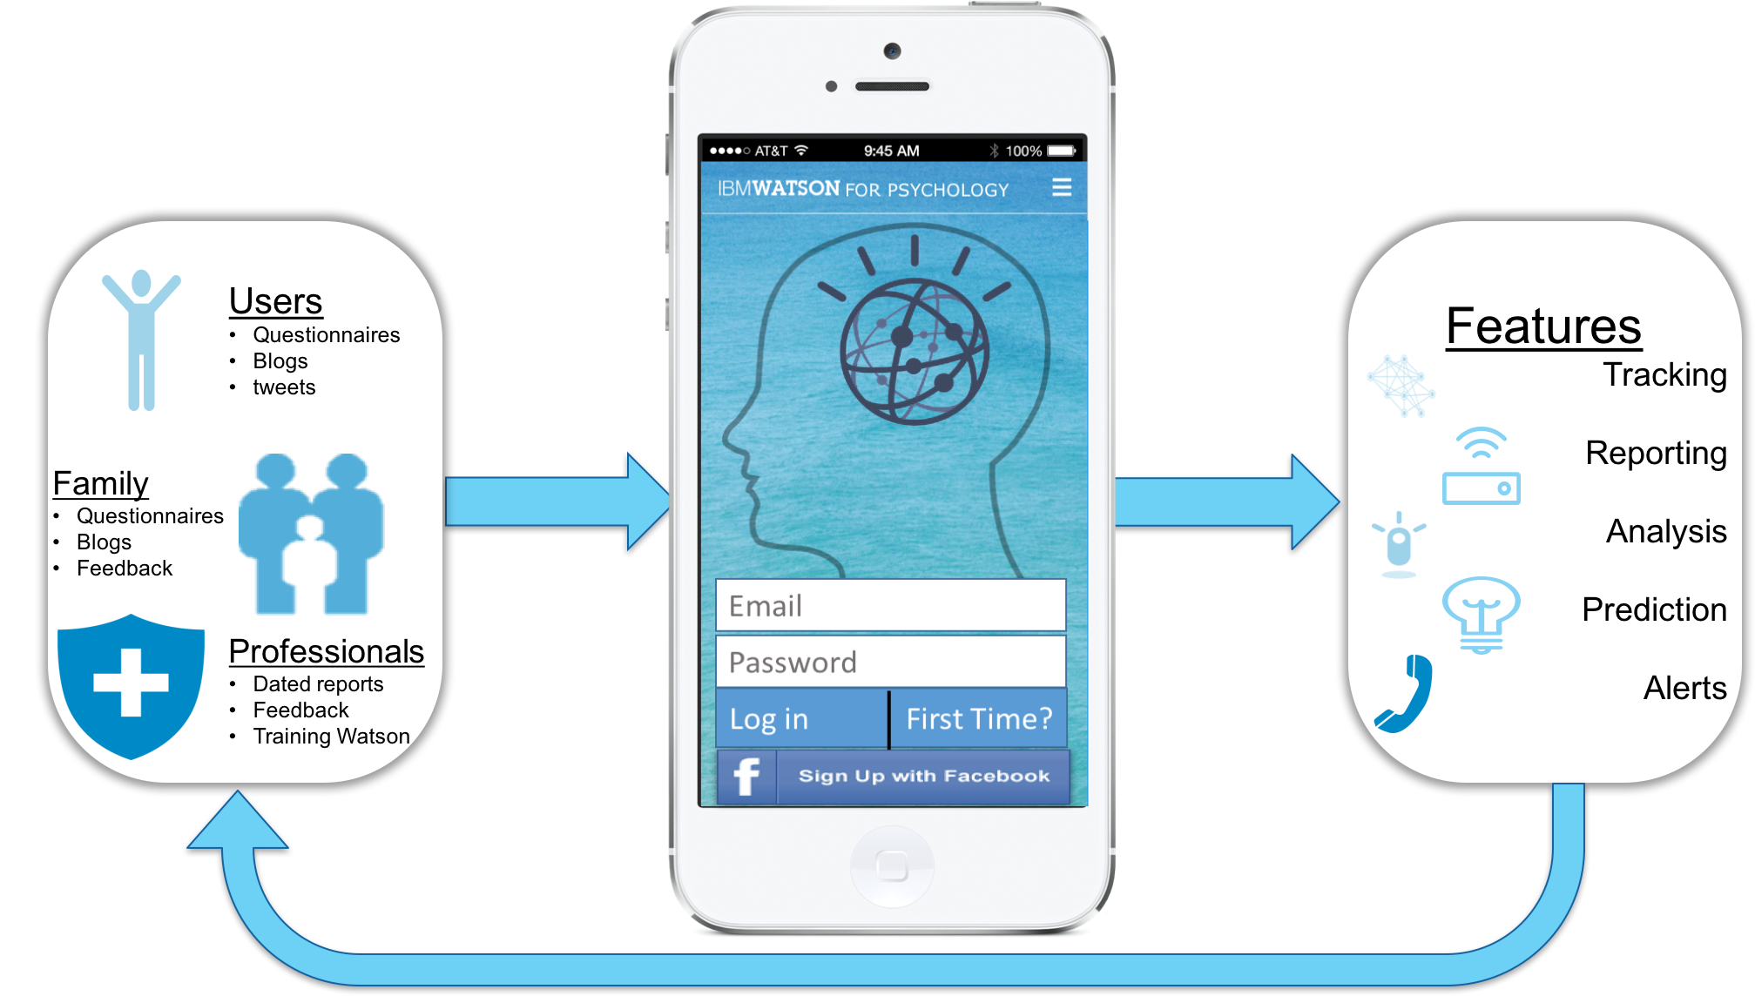
IBM Watson for Psychology – The App
Watson for Psychology is a supplemental solution for existing psychologists to track, record, and analyze behavioral data to provide both better recommendations and higher quality sessions with patients
Notes:
WHAT IT DOES:

Slide 5

How IBM Watson for Psychology was built
IDEA – Understanding Watson’s capabilities of learning and analysis to address the shortage of mental health care available
4 Business Minds – Idea first, code second
Research & Communication – Digest the DSM, the leading mental health guidebook within the medical community
Business Cases – Creating use cases from three perspectives: patient, family member, and practitioner.
Learning how to Code – Little to no app development experience, but persistence and the help of mentors allow us to overcome lack of knowledge
Watson for Psychology – Enables psychologists to better understand patients’ daily mental state and hope to revolutionize the field of psychology
One visionary, two high schoolers, and one old man
Notes:
HOW IT WAS BUILT:

Slide 6
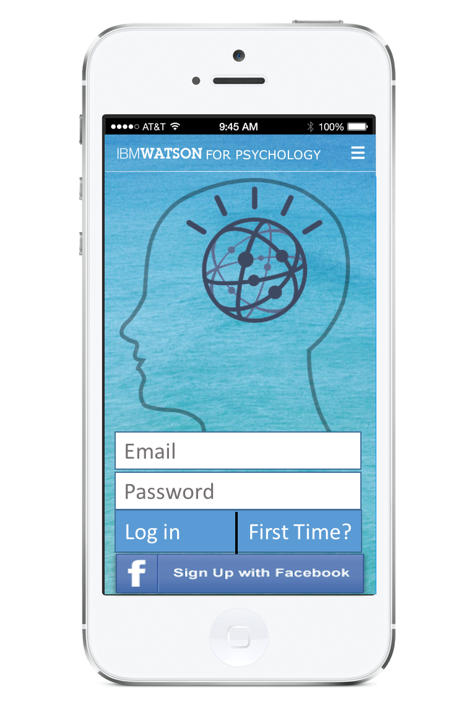


The Nuts & Bolts
Questionnaire
(answers)
(result)
(Python – Learning Alg)
Keyword Search (relevance, sentiment)
Emotion
Jquery
CSS
Javascript
HTML
PHP
Report (Rec for Psychologist)
Blogs
(entries)
(text)
(Python – Track Alg)
Emotion
Language Style
Social Tendencies
Jquery
CSS
Javascript
HTML
PHP

Slide 7
Providers & Insurers: A supplemental tool for Psychologists
Our scientific foundation and reliance on empirical evidence make us unique among mental and behavioral health practitioners (Peterson, 2003). Failure to recognize this fact in training programs and practice makes us vulnerable to being lumped together as generic mental health providers or business consultants, and we will be less competitive in the marketplace. - APA Presidential Address (2010)
Recent federal legislation requires more expansive insurance coverage for mental health services. The Mental Health Parity and Addiction Act of 2008 applies to large, employer-sponsored insurance plans. It bars insurers from putting up financial barriers to mental health care that are greater than those created for physical treatments. While there was some concern that the new requirements would lead employers to drop mental health coverage altogether, a poll by the Kaiser Family Foundation found only 2 percent did so.
Notes:
HOW WE PLAN TO SELL IT:

Slide 8
Beyond Psychology
Government
Social security determination, Crime, Military, Legislation
Business & Liability
Safety, Heavy Machinery, Responsibility
Notes:
ICING ON THE CAKE:

Slide 9
APPENDIX

Slide 10
Next Steps & Features
Features/Progress
User Interface
Security
Integrated API’s (generate dictionary from keywords and report relevance)
Next Steps
Implement Alchemy and Tone Analyzer learning algorithm
Integrate additional API’s (Conversation, Speech to Text)

Slide 11
Sources
APA Presidential address (Baylor College of Medicine): http://psych.colorado.edu/~willcutt/pdfs/bray_2010.pdf
Thoughts on improving psychology: https://thepsychologist.bps.org.uk/volume-22/edition-5/how-can-we-improve-psychological-science
Social security determination: http://www.news-medical.net/news/20150413/Broader-use-of-psychological-testing-may-improve-process-for-social-security-disability-determination.aspx
APA’s strategic plan: http://www.apa.org/monitor/2012/06/pc.aspx
Mental healthcare system facts: https://www.washingtonpost.com/news/wonk/wp/2012/12/17/seven-facts-about-americas-mental-health-care-system/

